Slide 1
Intro to Movement of robots and introduction to kinematics of robots
Notes:
January 21, 2002

Slide 2
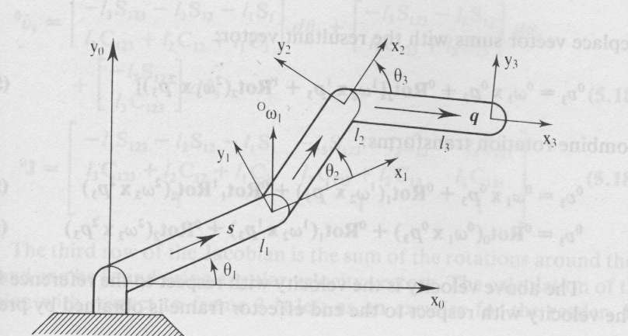
Kinematics: constraints on getting around the environment
kinematics
The effect of a robot’s geometry on its motion.
wheeled platforms
from sort of simple to sort of difficult
manipulator modeling

Slide 3
Effectors and Actuators
An effector is any device that affects the environment.
A robot's effector is under the control of the robot.
Effectors:
legs,
wheels,
arms,
fingers.
The role of the controller is to get the effectors to produce the desired effect on the environment,
this is based on the robot's task.

Slide 4
Effectors and Actuators
An actuator is the actual mechanism that enables the effector to execute an action.
Actuators typically include:
electric motors,
hydraulic cylinders,
pneumatic cylinders,
etc.
The terms effector and actuator are often used interchangeably to mean "whatever makes the robot take an action."
This is not really proper use:
Actuators and effectors are not the same thing.
And we'll try to be more precise.

Slide 5
Kinematics for Animals (and humans)

Slide 6
Review: degrees of freedom
Most simple actuators control a single degree of freedom,
i.e., a single motion (e.g., up-down, left-right, in-out, etc.).
A motor shaft controls one rotational degree of freedom, for example.
A sliding part on a plotter controls one translational degree of freedom.
How many degrees of freedom (DOF) a robot has is very important in determining how it can affect its world,
and therefore how well, if at all, it can accomplish its task.
We said many times before that sensors must be matched to the robot's task.
Similarly, effectors must be well matched to the robot's task also.
When you design a robot your first task is decide the number of DOF and the geometry.

Slide 7
DOF
In general, a free body in space as 6 DOF:
three for translation (x,y,z),
three for orientation/rotation (roll, pitch, and yaw).
You need to know, for a given effector (and actuator/s):
how many DOF are available to the robot,
how many total DOF any given robot has.
If there is an actuator for every DOF, then all of the DOF are controllable.
Usually not all DOF are controllable, which makes robot control harder.
To demonstrate, use a pen in your hand…..

Slide 8
DOF and controllable DOFs
A car has 3 DOF:
position (x,y) and
orientation (theta).
But only 2 DOF are controllable:
driving: through the gas pedal and the forward-reverse gear;
steering: through the steering wheel.
Since there are more DOF than are controllable, there are motions that cannot be done.
Example of such motions is moving sideways (that's why parallel parking is hard).

Slide 9
DOF for animals

Slide 10
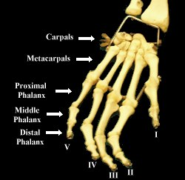
One Minute Test
How many degrees of freedom does your hand have, with your forearm fixed in position?
(Hint: It’s not 6)
Answer on next slide

Slide 11
Degrees of Freedom in Hand
Part
DoF
Comment
Wrist
2
Side-to-side
Up-down
Palm
1
Open-close a little
Fingers
4*4
2 @ base (Up-down & side-to-side)
1 @ each of two joints
Thumb
4
2 @ base (attached to wrist)
2 @ visible joints
Total
23
Hand has 23 degrees of freedom

Slide 12
Total and Controllable DOFs
y
Kinematics: wheeled platforms vs. robot arms (or legs)
x
V_{L}
V_{R}
We need to make a distinction between what an actuator does (e.g., pushing the gas pedal) and what the robot does as a result (moving forward).
A car can get to any 2D position but it may have to follow a very complicated trajectory.
Parallel parking requires a discontinuous trajectory with respect to the velocity.
It means that the car has to stop and go.

Slide 13
What is a HOLONOMIC robot?

Slide 14
Definition of a HOLONOMIC robot
When the number of controllable DOF is equal to the total number of DOF on a robot, the robot is called holonomic. (i.e. the hand built by Uland Wong).
Holonomic <= > Controllable DOF = total DOF

Slide 15
DOF versus types of robots
Non-Holonomic <= > Controllable DOF < total DOF
If the number of controllable DOF is smaller than total DOF, the robot is non-holonomic.
If the number of controllable DOF is larger than the total DOF, the robot is redundant. (like a human hand, we did not build such robot yet)
Redundant <= > Controllable DOF > total DOF

Slide 16
DOF for animals
A human arm has 7 DOF:
3 in the shoulder,
1 in the elbow,
3 in the wrist
All of which can be controlled.
A free object in 3D space (e.g., the hand, the finger tip) can have at most 6 DOF!
So there are redundant ways of putting the hand at a particular position in 3D space.
This is the core of why robot manipulation is very hard!
One minute test!

Slide 17
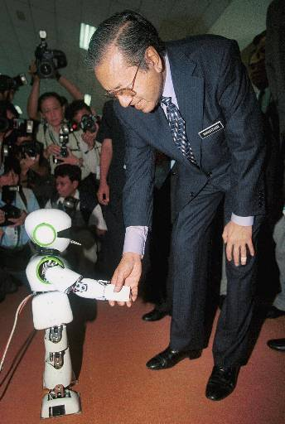
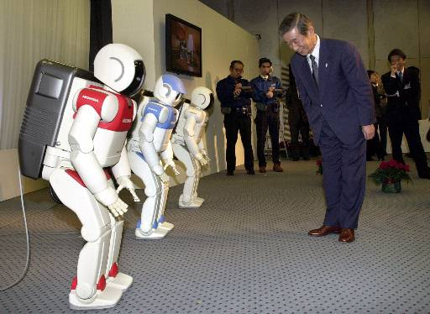
JAPAN HONDA AND SONY ROBOTS
Pino, a 70-centimeter (2-foot)-tall and 4.5-kilogram (9-pound) humanoid robot designed by Japan Science and Technology Corporation in Tokyo which can walk on its legs and respond to stimulation through a sensor, shakes hand with Malaysia's Prime Minister Mahathir Mohamad during the opening of the Expo Science & Technology 2001 in Kuala Lumpur, Malaysia, Monday, July 2, 2001. (AP Photo/Andy Wong)
Question: how many DOF?

Slide 18
98 degrees (of freedom)
This is in any case simplified

Slide 19
Anatomical Coordinates and Robots that mimick animals

Slide 20
Human Anatomical Coordinates – important in work on humanoid robots
Sagittal Plane
Coronal Plane
Transverse Plane

Slide 21
Animal Anatomical Coordinates
We built robot fishes, horses, dogs and other animals.

Slide 24
Prosthetic Arms and Hands

Slide 25
Knowledge of bio-mechanics is useful to design hands, necks, heads for animatronic robots

Slide 26
Types of kinematic Systems

Slide 27
Robot Arms for Space, All kinds of manipulators

Slide 28
Robot Arms for Space

Slide 29
Serial Robotic Manipulators

Slide 30
Serial Robotic Manipulators
Serial chain of robotic links and joints.
Large workspace
Low stiffness
Cumulative errors from link to link
Proximal Link – closer to the base
Distal Link – farther from the base
Proximal links carry the weight and load of distal links
Actuation of proximal joints affects distal links.
Limited load-carrying capability at the end effector.

Slide 34
Parallel Robotic Mechanisms

Slide 35
Parallel Robotic Mechanisms
End plate is directly actuated by multiple links and joints.
Multiple links and joints are called a kinematic chain.
The workspace is restricted
Common link-joint configuration
This can serve as Pick-and-Place Robot
Light construction
Stiffness
High load-carrying capacity.
We use it for waist in MCECS BOT.

Slide 36
Manipulation

Slide 37
Manipulation

Slide 38
Manipulation
In locomotion (mobile robot), the body of the robot is moved to get to a particular position and orientation.
In contrast - a manipulator moves itself
typically to get the end effector (e.g., the hand, the finger, the fingertip)
to the desired 3D position and orientation.
So imagine having to touch a specific point in 3D space with the tip of your index finger;
that's what a typical manipulator has to do.

Slide 39
Issues in Manipulation
In addition: manipulators need to:
grasp objects,
move objects.
But those tasks are extensions of the basic reaching discussed above.
The challenge is to get there efficiently and safely.
Because the end effector is attached to the whole arm, we have to worry about the whole arm:
the arm must move so that it does not try to violate its own joint limits,
it must not hit itself or the rest of the robot, or any other obstacles in the environment.

Slide 40
Manipulation - Teleoperation
Thus, doing autonomous manipulation is very challenging.
Manipulation was first used in tele-operation, where human operators would move artificial arms to handle hazardous materials.
Complicated duplicates of human arms, with 7 DOF were built.
It turned out that it was quite difficult for human operators to learn how to tele-operate such arms

Slide 41
Manipulation and Teleoperation: Human Interface
Exoskeletons better than joysticks
One alternative today is to put the human arm into an exo-skeleton, in order to make the control more direct.
Using joy-sticks, for example, is much harder for high DOF.
Exo-skeletons used in “Hollywood Robotics”

Slide 42
Why is using joysticks so hard?
Because even as we saw with locomotion, there is typically no direct and obvious link between:
what the effector needs to do in physical space
and what the actuator does to move it.
In general, the correspondence between actuator motion and the resulting effector motion is called kinematics.
In order to control a manipulator, we have to know its kinematics:
1. what is attached to what,
2. how many joints there are,
3. how many DOF for each joint,
etc.

Slide 43
Basic Problems for Manipulation
Kinematics
Given all the joint angles - where is the tip ?
Inverse Kinematics
Given a tip position - what are the possible joint angles ?
Dynamics
To accelerate the tip by a given amount how much torque should a particular joint motor put out ?

Slide 44
Kinematics versus Inverse Kinematics
We can formalize all of this mathematically.
To get an equation which will tell us how to convert from, say, angles in each of the joints, to the Cartesian positions of the end effector/point is called:
computing the manipulator kinematics
The process of converting the Cartesian (x,y,z) position into a set of joint angles for the arm (thetas) is called:
inverse kinematics.
Something for lovers of math and programming! Publishable! LISP

Slide 45
Manipulators

Slide 46
Manipulators
Robot arms, industrial robot
Rigid bodies (links) connected by joints
Joints: revolute or prismatic
Drive: electric or hydraulic
End-effector (tool) mounted on a flange or plate secured to the wrist joint of robot

Slide 47
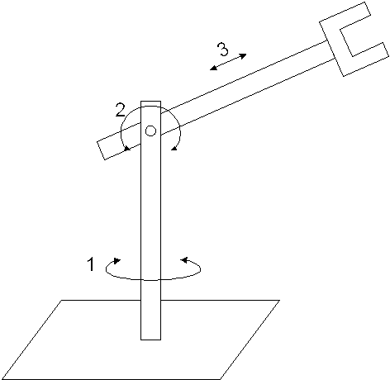
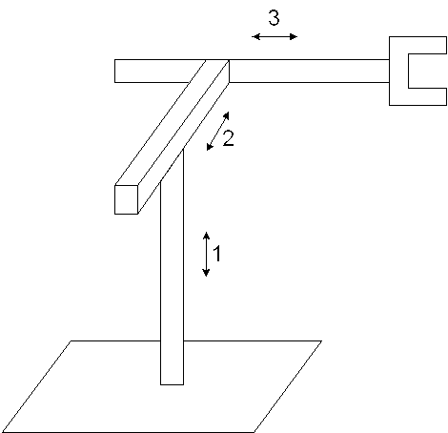
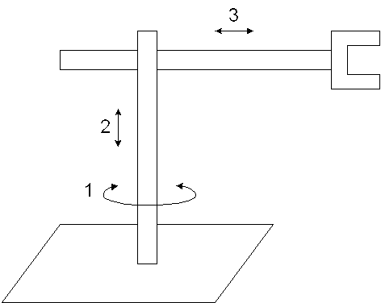
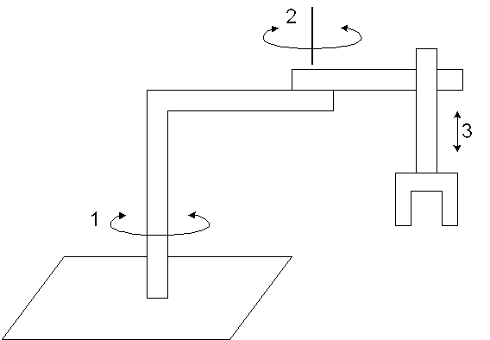
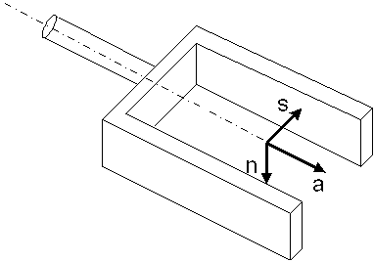
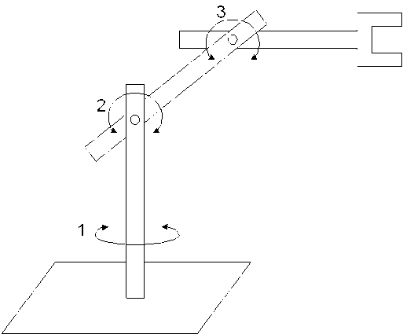
Manipulators: Robot Configurations
Cartesian: PPP
Cylindrical: RPP
Spherical: RRP
Hand coordinate:
n: normal vector; s: sliding vector;
a: approach vector, normal to the
tool mounting plate
SCARA: RRP
(Selective Compliance Assembly Robot Arm)
Articulated: RRR

Slide 48
Manipulators: Motion Control Methods
Point to point control
a sequence of discrete points
spot welding, pick-and-place, loading & unloading
Continuous path control
follow a prescribed path, controlled-path motion
Spray painting, Arc welding, Gluing

Slide 49
Manipulators: Robot Specifications
Number of Axes
Major axes, (1-3) => Position the wrist
Minor axes, (4-6) => Orient the tool
Redundant, (7-n) => reaching around obstacles, avoiding undesirable configuration
Degree of Freedom (DOF)
Workspace
Payload (load capacity)
Precision v.s. Repeatability
Which one is more important?
Notes:
Precision (validity) is defined as how accurately a specified point can be reached. It is a function of the resolution of the actuators, as well as its feedback devices. Most industrial robots can have precision of 0.001 inch or better.
Repeatability (variability) is how accurately the same position can be reached if the motion is repeated many times. The robot may not reach the same point every time, but will be within a certain radius from the desired point. The radius of a circle that is formed by this repeated motion is called repeatability. It is much more important than precision. If a robot is not precise, it will generally show a consistent error, which can be predicted and thus corrected through programming. However, if the error is random, it cannot be predicted and thus cannot be eliminated. Repeatability defines the extent of this random error. Manufactures must specify repeatability in conjunction with the number of tests, the applied payload during the tests, and the orientation of the arm. Have repeatability in the 0.001 inch range.
Depending on their configuration and the size of their links and wrist joints, robots can reach a collection of points called a workspace.
Payload is the weight a robot can carry and still remain within its other specification.

Slide 50
Joints.
Joints connect parts of manipulators.
The most common joint types are:
revolute link (rotation around a fixed axis)
prismatic link (linear movement)
These joints provide the DOF for an effector.
Prismatic Link

Slide 51
Joints.
Revolute Link

Slide 52
Revolute Robotic Joints

Slide 54
Prismatic Robotic Joints

Slide 56
Other Robotic Joints

Slide 58
Assembly Robot Configurations and Workspaces

Slide 61
Terms for manipulation
Links and joints
End effector, tool
Accuracy vs. Repeatability
Workspace
Reachability
Manipulability
Redundancy
Configuration Space

Slide 62
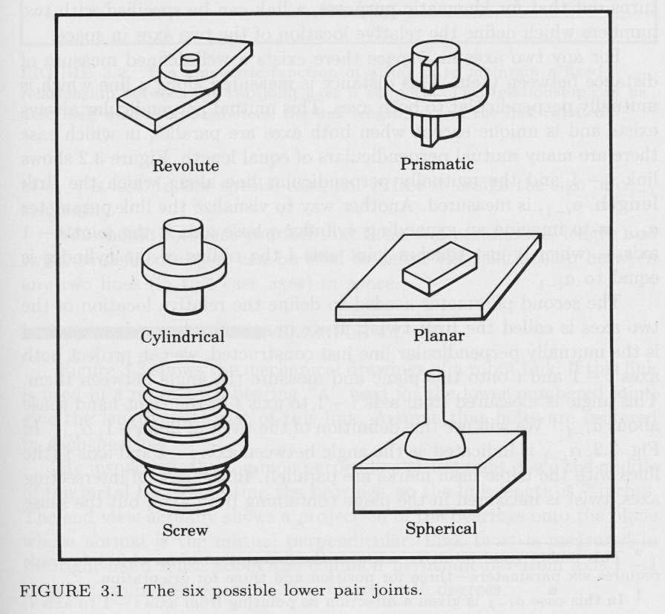
Types of Manipulators
Basic distinction: what kinds of joints extend from base to end.
“RR” or “2R”
“PR” arm
All manipulators can be represented as chains of P (prismatic) and R (rotational) joints.

Slide 63
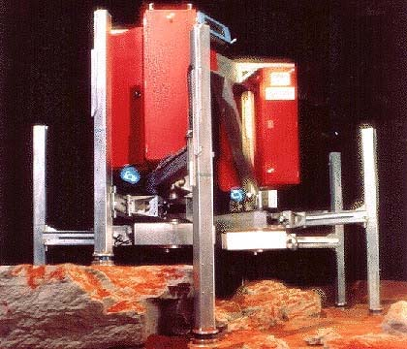
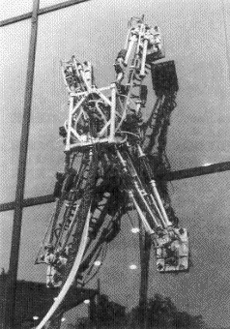
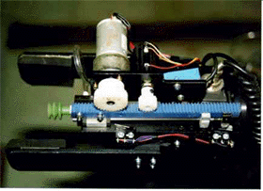
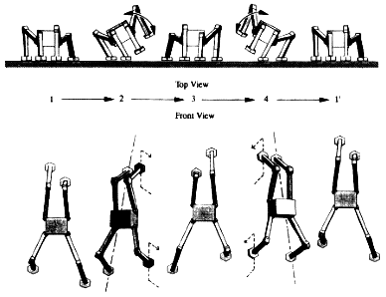
Prismatic Joints
Ninja
Ambler
tomato harvester

Slide 64
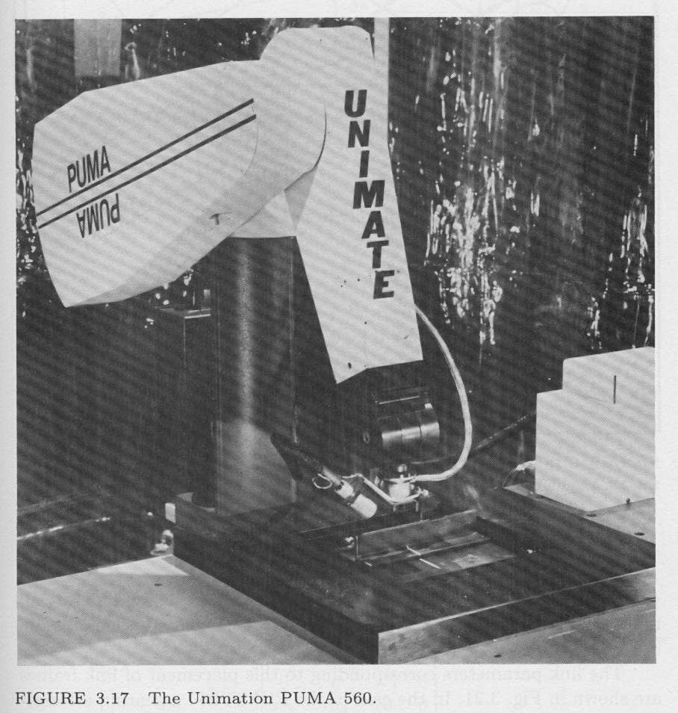
Challenges in kinematics design
1. Modeling many degrees of freedom
2. No closed-form solution guaranteed for the inverse kinematics.
3. Trajectory generation under nonholonomic constraints
4. Navigating with obstacles
obstacle
goal

Slide 65
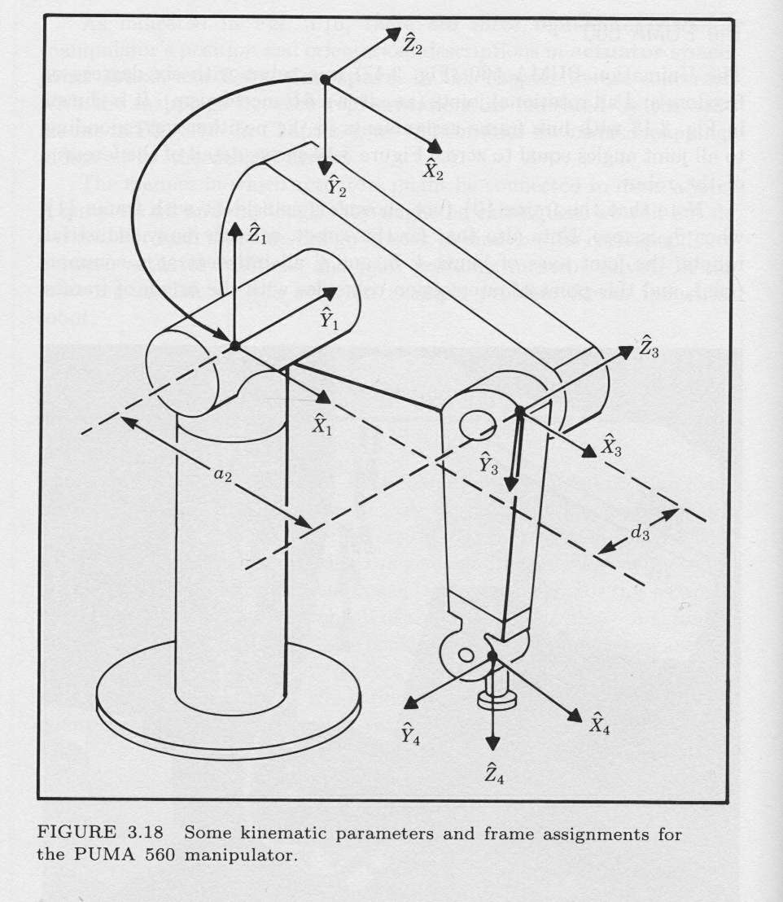
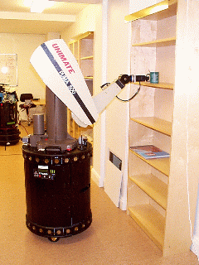
Challenges: multiple solutions
Multiple solutions (or no solutions) for a task.

Slide 66
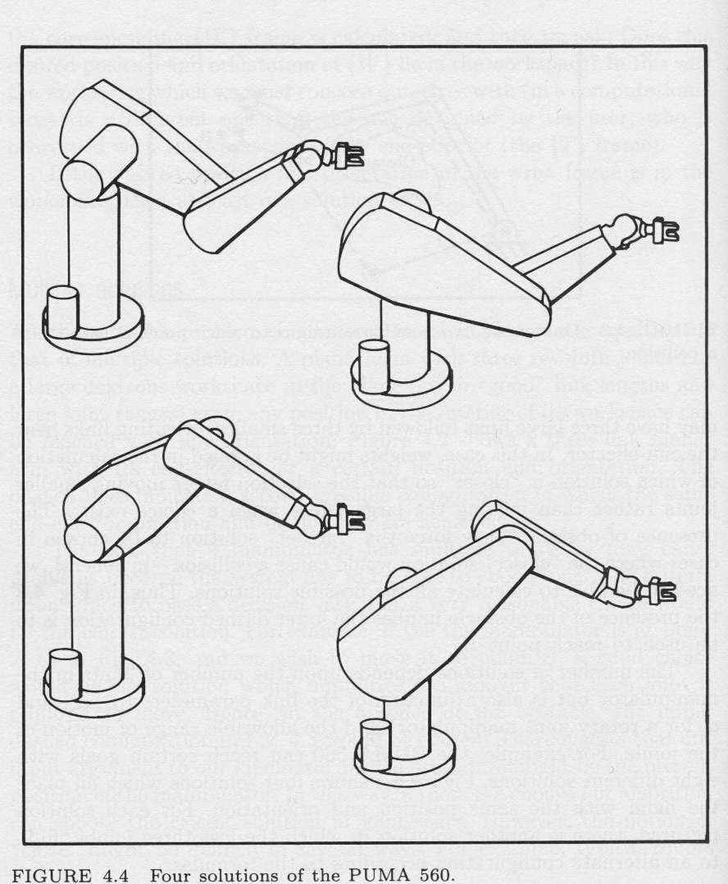
Challenges
Multiple solutions (or no solutions) for a task.

Slide 67
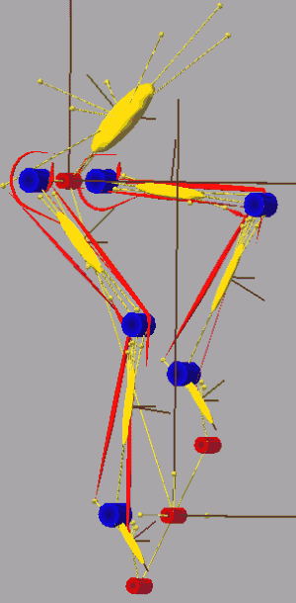
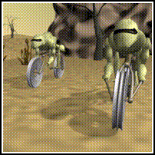
Opportunities
Direct kinematic/ inverse kinematic modeling - is the basis for control of the vast majority of industrial robots.
Accurate (inverse) kinematic models are required in order to create believable character animations
how would these things bike?

Slide 68
Homogeneous Transformation

Slide 70
Homogeneous Transformation

Slide 73
Examples of Manipulators

Slide 79
Manipulator Redundancy and Degeneracy

Slide 88
Sources
Robert Stengel
Prof. Maja Mataric
Dr. Fred Martin
Bryce Tucker and former PSU students
A. Ferworn,
Prof. Gaurav Sukhatme, USC Robotics Research Laboratory
Paul Hannah
Reuven Granot, Technion
Dodds, Harvey Mudd College

